Slide 1



OPEN CV PROJECT Virtual Paint
SHARUN KUMAR C R
B.E. Computer Science and Engingineering
Vel Tech High Tech Dr.Rangarajan Dr.Sakunthala Engineering College
Intern in Indian Servers
IndServ21a164

Slide 2
PROJECT DESCRIPTION
I want to draw my imagination by just waving my finger in the air. In this project, i build an Virtual paint which can draw anything on it by just capturing the motion of my finger with a camera. Here the tip of the finger is used as the marker.
We will be using the computer vision techniques of OpenCV to build this project.

Slide 3
Algorithm Requirements: python3,mediapipe, numpy , opencv installed on your system.
import necessary library
with library also importing hand tracking module
Start reading the frames and convert the captured frames to RGB colourspace
Prepare the paint frame and put the respective ink buttons on it.
then detect the fingers if my only index finger is shown then its in drawing mode else its in selection mode

Slide 4
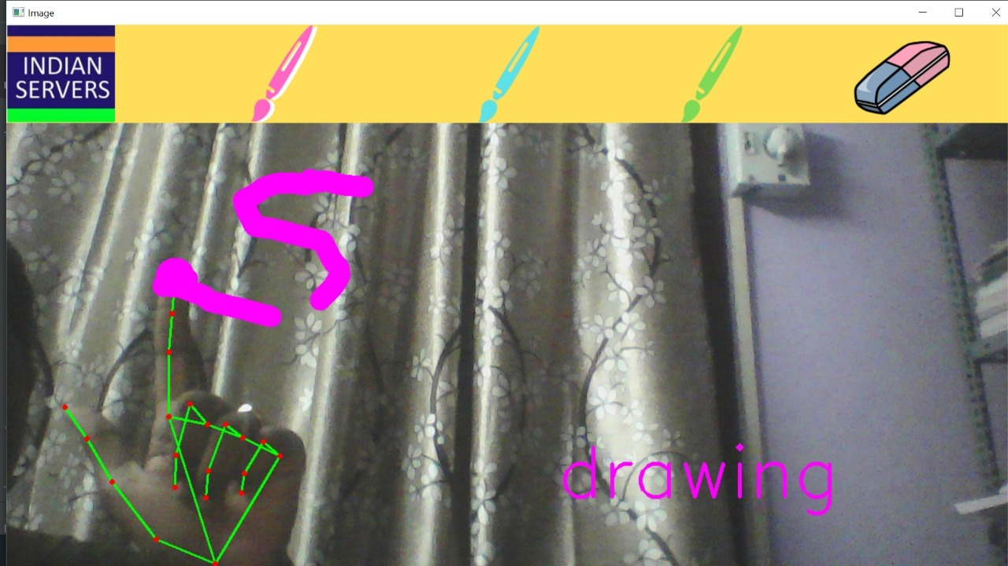
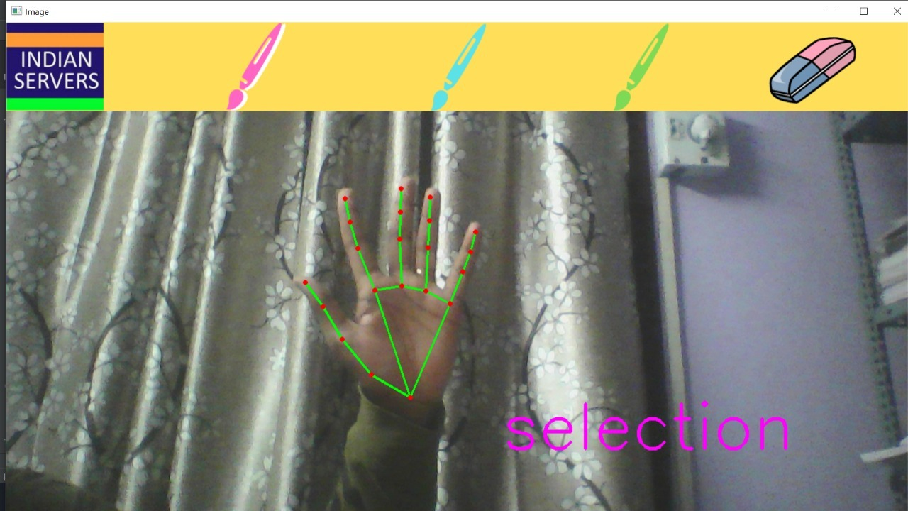
FINGER DETECTION
DRAWING MODE SELECTION MODE

Slide 5
Algorithm Requirements: python3,mediapipe, numpy , opencv installed on your system.
import necessary library
with library also importing hand tracking module
Start reading the frames and convert the captured frames to RGB colourspace
Prepare the paint frame and put the respective ink buttons on it.
then detect the fingers if my only index finger is shown then its in drawing mode else its in selection mode
From Detect the fore finger, find the center coordinates and keep storing them in the array for successive frames (Arrays for drawing points on canvas)
Finally draw the points stored in an array on the frames and canvas.

